Slide 1
A Simple Computer Architecture

Slide 2
Breakdown of a Computing Problem
Problem
Algorithms
Programming in
High-Level Language
Compiler/Assembler/
Linker
Instruction Set Architecture (ISA)
Target Machine
(one implementation)
Micro-architecture
System architecture
Functional units/
Data Path
Human Level
System Level
Gates Level
Design
RTL Level
Logic Level
Circuit Level
Silicon Level
Transistors
Manufacturing

Slide 3

Control Word
n
R
W
0
Write
D data
15
D
A
14
D address
13
8
x
n
How to program & control ?
Register file
12
A address
B address
9
AA
11
8
BA
10
A data
B data
7
n
n
Constant in
n
6
1
0
MB
Bus A
MUX B
n
Bus B
n
Address out
Data out
A
B
V
5
C
Function
4
FS
N
unit
3
Z
2
n
n
Data in
0
1
MD
1
MUX D
DATAPATH
Bus D

Slide 4

ISA design principles
main() {
int i,b,c,a[10];
for (i=0; i<10; i++)…
a[2] = b + c*i;
}
High Level Language
Compiler
…
lw r2, mem[r7]
add r3, r4, r2
st r3, mem[r8]
ISA
Binary code
Assembler

Slide 5
General Purpose Computer
Von Neumann Machine
Memory
0101 1001 1010 1001 1000
0100 1000 1110 1111 0011
0010 1011 1000 …… ……
A stored-program computer called EDVAC proposed in 1944 while developing ENIAC, first general purpose computer
Contributors:
Presper Eckert
John Mauchly
John von Neumann
Data &
Instruction
Data
Central Processing Unit
(CPU)

Slide 6
Basic Operation
1000 1100 1110 0010 0000 0000 0000 0000
Instruction fetch from memory
Control Unit
It’s called Harvard Architecture (Mark-III/IV) if instruction and data memory are separated
Datapath Unit
Data written back to memory
MICROPROCESSOR

Slide 7
Program Counter
main:
la $8, array
lb $9, ($8)
lb $10, 1($8)
add $11, $9, $10
sb $11, ($8)
addiu $8, $8, 4
lh $9, ($8)
lhu $10, 2($8)
add $11, $9, $10
sh $11, ($8)
addiu $8, $8, 4
lw $9, ($8)
lw $10, 4($8)
sub $11, $9, $10
sw $11, ($8)
How a sequence of instructions are fetched and executed by a computer?
Program Counter (PC)
A special register
Provide the logical ordering of a program
Point to the address of the instruction to be executed
PC

Slide 8
Instruction Set Architecture (ISA) for Simple Computer (SC)
A programmable system uses a sequence of instructions to control its operation
An typical instruction specifies:
Operation to be performed
Operands to use, and
Where to place the result, or
Which instruction to execute next
Instructions are stored in RAM or ROM as a program
The addresses for instructions in a computer are provided by a program counter (PC) that can
Count up
Load a new address based on an instruction and, optionally, status information

Slide 9
Instruction Set Architecture (ISA)
The PC and associated control logic are part of the Control Unit
Executing an instruction - activating the necessary sequence of operations specified by the instruction
Execution is controlled by the control unit and performed:
In the datapath
In the control unit
In external hardware such as memory or input/output

Slide 10
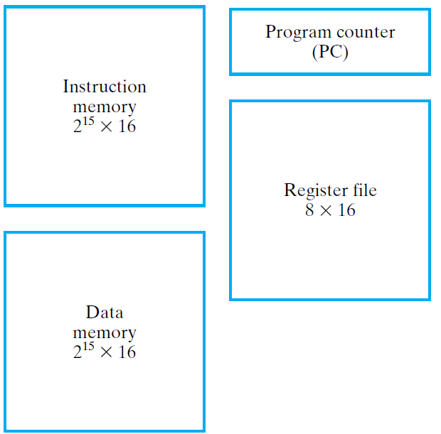
ISA: Storage Resources
The storage resources are "visible" to the programmer at the lowest software level (typically, machine or assembly language)
Separate instruction and data memories imply "Harvard architecture"

Slide 11
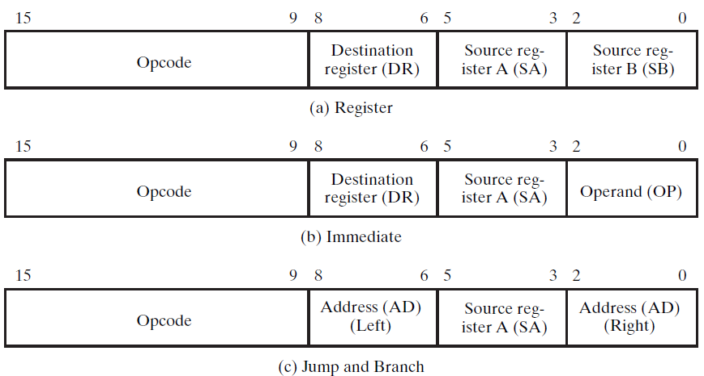
ISA: Instruction Format
A instruction consists of a bit vector
The fields of an instruction are subvectors representing specific functions and having specific binary codes defined
The format of an instruction defines the subvectors and their function

Slide 12
ISA: Instruction Format (continued)
15
9
8
6
5
3
2
0
Destination
Source reg-
Source reg-
Opcode
register (DR)
ister A (SA)
ister B (SB)
(a) Register
This format supports instructions represented by:
R1 ← R2 + R3
R1 ← sl R2
There are three 3-bit register fields:
DR - specifies destination register (R1 in the examples)
SA - specifies the A source register (R2 in the first example)
SB - specifies the B source register (R3 in the first example and R2 in the second example)

Slide 13
ISA: Instruction Format (continued)
15
9
8
6
5
3
2
0
Opcode
Destination
Source reg-
Operand (OP)
register (DR)
ister A (SA)
(b) Immediate
This format supports instructions described by:
R1 ← R2 + 3
The B Source Register field is replaced by an Operand field OP which specifies a constant.
The Operand:
3-bit constant
Values from 0 to 7
The constant:
Zero-fill (on the left of) the Operand to form 16-bit constant
16-bit representation for values 0 through 7

Slide 14
ISA: Instruction Format (continued)
15
9
8
6
5
3
2
0
Address (AD)
Source reg-
Address (AD)
Opcode
(Left)
ister A (SA)
(Right)
(c) Jump and Branch
This instruction supports changes in the sequence of instruction execution by adding an extended, 6-bit, signed 2s-complement address offset to the PC value
The 6-bit Address (AD) field replaces the DR and SB fields
Example: Suppose that a jump is specified by the Opcode and the PC contains 45 (0…0101101) and Address contains – 12 (110100). Then the new PC value will be: 0…0101101 + (1…110100) = 0…0100001 (45 + (– 12) = 33)
The SA field is retained to permit jumps and branches on N or Z based on the contents of Source register A

Slide 15
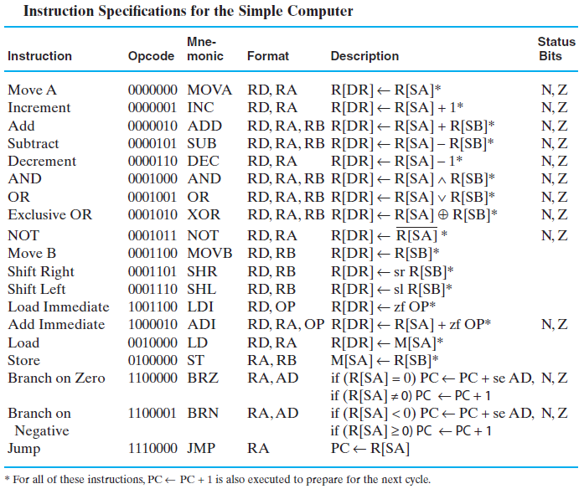
ISA: Instruction Specifications

Slide 16


ISA:Example Instructions

Slide 17
Single-Cycle Hardwired Control
The PC is controlled by Branch Control logic
PL – load enable for the PC
JB – Jump/Branch select:
If JB = 1, Jump, else Branch
BC – Branch Condition select: If BC = 1, branch for N = 1, else branch for Z = 1.
Based on the ISA defined, design a computer architecture to support the ISA
The architecture is to fetch and execute each instruction in a single clock cycle

Slide 18
PC Function
PC function is based on instruction specifications involving jumps and branches
In addition to the above register transfers, the PC must also implement: PC ← PC + 1
The first two transfers above require addition to the PC of: Address Offset = Extended IR(8:6) || IR(2:0)
The third transfer requires that the PC be loaded with: Jump Address = Bus A = R[SA]
The counting function of the PC requires addition to the PC of 1
Branch
on
Zero
BRZ
if (R[
S
A] =
0) PC
←
PC
+ s
e
A
D
Branch
on
Negative
BRN
if (R[
S
A] <
0) PC
←
PC
+ s
e
A
D
J
←
u
mp
JMP
P
C
R[SA
]

Slide 19
Instruction Decoder
The combinational instruction decoder converts the instruction into the signals necessary to control all parts of the computer during the single cycle execution
The input is the 16-bit Instruction
The outputs are control signals:
Register file addresses DA, AA, and BA,
Function Unit Select FS
Multiplexer Select Controls MB and MD,
Register file and Data Memory Write Controls RW and MW, and
PC Controls PL, JB, and BC
The register file outputs are simply pass-through signals: DA = DR, AA = SA, and BA = SB .

Slide 20
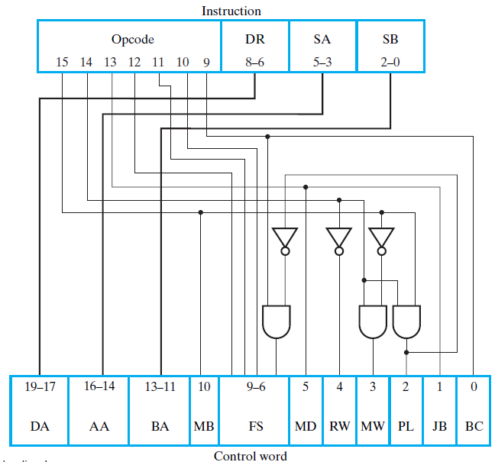
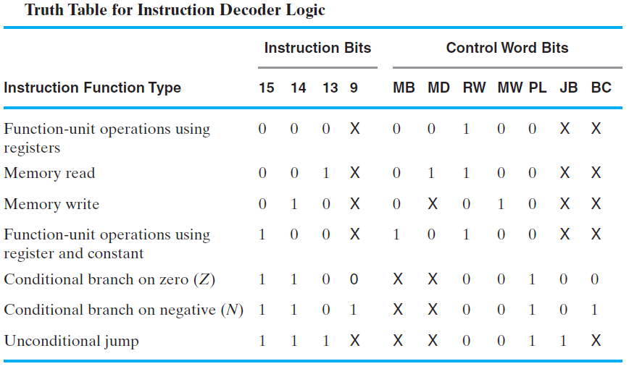

Slide 21
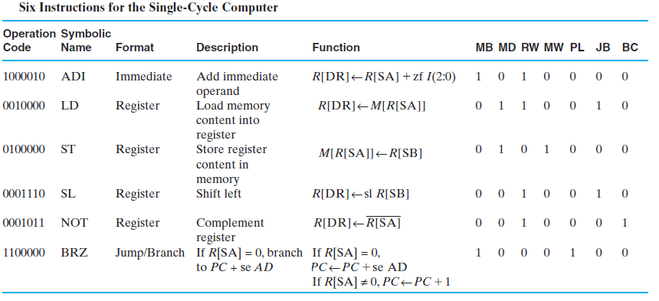
Example Instruction Execution

Slide 22
Decoding for ADI
1 0 0 0 0 1 0
Instruction
Opcode
DR
SA
SB
15
14
13
12
11
10
9
8
–
6
5
–
3
2
–
0
16
19
–
14
–
17
13
–
11
10
9
–
6
5
4
3
2
1
0
1
0 0 1 0
0
1
0
0
0
0
DA
AA
BA
MB
FS
MD
RW
MW
PL
JB
BC
Control word

Slide 23
Extend
IR(8:6) || IR(2:0)
V
C
Branch
PC
Control Inputs and Paths for ADI
N
Control
Z
P
J
B
Address
L
B
C
Instruction
1
0
0
0
memory
RW
D
Instruction
DA
Register
Increment PC
AA
A
file
B
BA
IR(2:0)
Zero fill
Constant
Instruction decoder
in
1
0
MB
1
MUX B
Address out
Bus A
Bus B
0
No Write
Data out
MW
D
B
A
M
F
M
R
M
P
J
B
0 0 1 0
A
A
A
B
S
D
W
W
L
B
C
A
+
B
Data in
Address
1
0
1
0
0
0
0
FS
0 0 1 0
CONTROL
V
Function
Data
C
unit
memory
N
Data out
Z
F
Data in
0
MD
0
1
Bus D
MUX D
DATAPATH

Slide 24
Decoding for LD
0 0 1 0 0 0 0
Instruction
Opcode
DR
SA
SB
15
14
13
12
11
10
9
8
–
6
5
–
3
2
–
0
16
19
–
14
–
17
13
–
11
10
9
–
6
5
4
3
2
1
0
0
0 0 0 0
1
1
0
0
1
0
DA
AA
BA
MB
FS
MD
RW
MW
PL
JB
BC
Control word

Slide 25
Extend
IR(8:6) || IR(2:0)
V
C
Branch
PC
Control Inputs and Paths for LD
N
Control
Z
P
J
B
Address
L
B
C
Instruction
1
0
1
0
memory
RW
D
Instruction
DA
Register
Increment PC
AA
A
file
B
BA
IR(2:0)
Zero fill
Constant
Instruction decoder
in
1
0
MB
0
MUX B
Address out
Bus A
Bus B
0
No Write
Data out
MW
D
B
A
M
F
M
R
M
P
J
B
0 0 0 0
A
A
A
B
S
D
W
W
L
B
C
A
B
Data in
Address
0
1
1
0
0
1
0
FS
0 0 0 0
CONTROL
V
Function
Data
C
unit
memory
N
Data out
Z
F
Data in
1
MD
0
1
Bus D
MUX D
DATAPATH

Slide 26
Decoding for BRZ
1 1 0 0 0 0 0
Instruction
Opcode
DR
SA
SB
15
14
13
12
11
10
9
8
–
6
5
–
3
2
–
0
16
19
–
14
–
17
13
–
11
10
9
–
6
5
4
3
2
1
0
1
0 0 0 0
0
0
0
1
0
0
DA
AA
BA
MB
FS
MD
RW
MW
PL
JB
BC
Control word

Slide 27
Extend
IR(8:6) || IR(2:0)
V
C
Branch
PC
Control Inputs and Paths for BRZ
N
Control
Z
No Write
P
J
B
Address
L
B
C
Instruction
0
1
0
0
memory
RW
D
Instruction
DA
Register
Branch on
Z
AA
A
file
B
BA
IR(2:0)
Zero fill
Constant
Instruction decoder
in
1
0
MB
1
MUX B
Address out
Bus A
Bus B
0
No Write
Data out
MW
D
B
A
M
F
M
R
M
P
J
B
0 0 0 0
A
A
A
B
S
D
W
W
L
B
C
A
B
Data in
Address
1
0
0
0
1
0
0
FS
0 0 0 0
CONTROL
V
Function
Data
C
unit
memory
N
Data out
Z
F
Data in
0
MD
0
1
Bus D
MUX D
DATAPATH

Slide 28
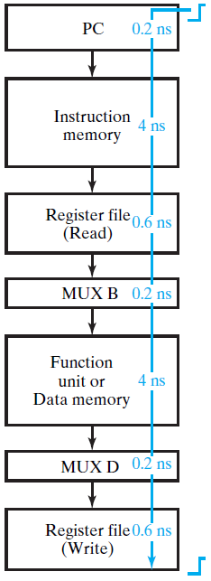
Single-Cycle Computer Issues
Shortcoming of Single Cycle Design
Complexity of instructions executable in a single cycle is limited
Accessing both an instruction and data from a simple single memory impossible
A long worst case delay path limits clock frequency and the rate of performing instructions

